Slide 1
Practical Kinetics
Exercise 3:
Initial Rates vs. Reaction Progress Analysis
Objectives:
Initial Rates
Whole Reaction Kinetic Analysis
Extracting Rate Constants

Slide 2
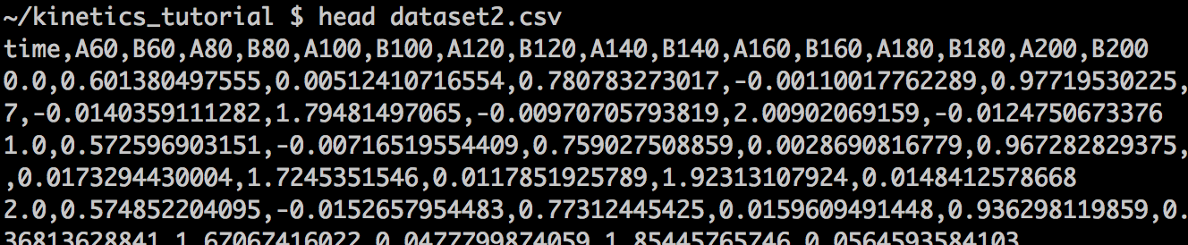
Introduction
In this exercise, we will examine a concentration vs. time dataset for a hypothetical stoichiometric reaction:
What is the order in A?
What is the rate constant?
In dataset2.csv, you will find 8 experimental runs. Each column is labeled by the reagent name and the starting concentration of A in units of 0.01 M. For example, A60 and B60 are the concentrations of A and B with a starting A concentration of 0.60 M. Each run contains 1000 s worth of data in CSV format:

Slide 3
Step 1: Introduction to Pandas
We will need some import statements:
import matplotlib
import matplotlib.pyplot as plt
%matplotlib inline
import numpy as np
import pandas as pd
from pandas import Series, DataFrame
from scipy.optimize import curve_fit
from scipy.stats import linregress
Pandas, introduced in Exercise 2, is a data analysis package. It will let us keep track of our data in a central “spreadsheet” called a DataFrame. Each column of data is called a Series. This will be much more convenient than using many lists or numpy arrays.
We will also need to do linear regression using scipy.stats.linregress.

Slide 4
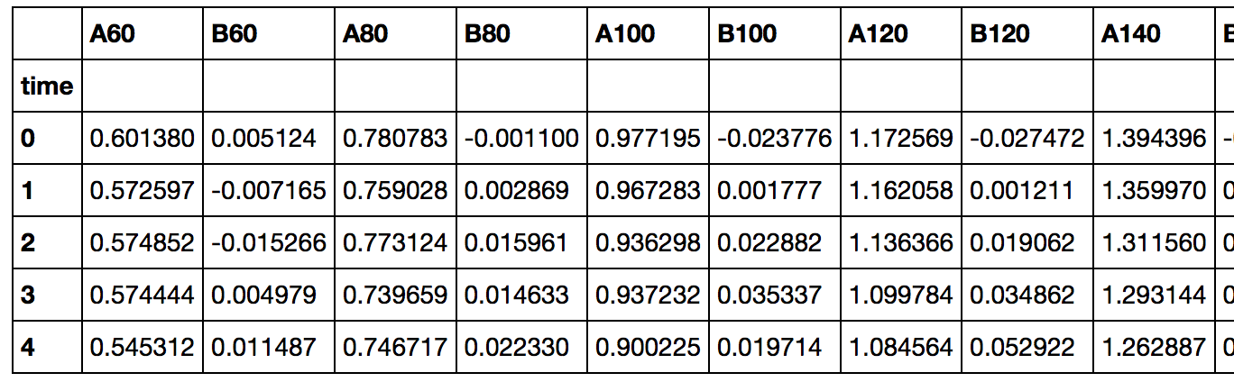
Step 1: Introduction to Pandas
Let’s read the CSV with Pandas:
df = pd.read_csv("dataset2.csv")
df.set_index("time",inplace=True)
time = df.index
df.head()
This generates a DataFrame (df). We are looking at the start (head) of it:
For a discussion of indexing and the many features of Pandas:
http://byumcl.bitbucket.org/bootcamp2013/labs/pd_types.html

Slide 5
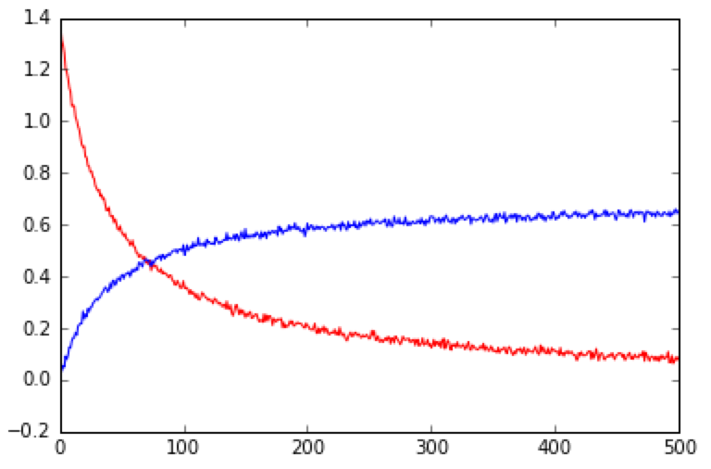
Step 2: A First Look
[A], [B] vs. time
plt.plot(time, df.A140, "r")
plt.plot(time, df["B140"], "b")
plt.show()
There are two ways to access a column of a pandas DataFrame.
Method 1: We can type df.column_name (if there are no special characters).
Method 2: We can also type df[“column_name”]. This form is handy because we can generate the necessary strings with a loop (coming up soon).
Regardless of the method used, one obtains a pandas.Series object. This is analogous to a numpy array.
Technical Note: Slicing syntax can be used on either DataFramers or Series, but the syntax is inclusive of the final index.

Slide 6
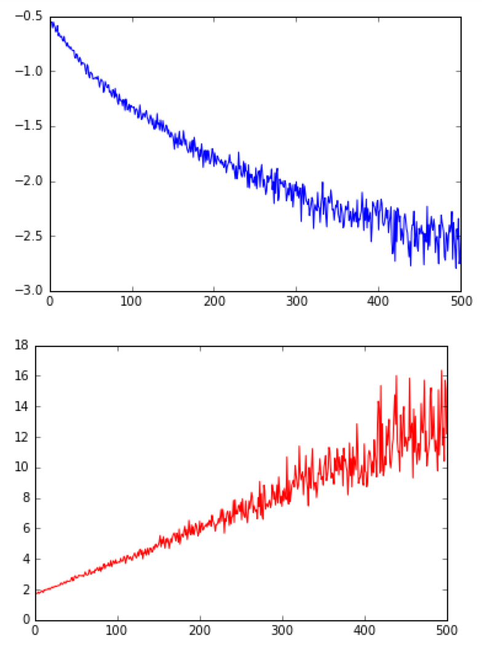
Step 2: A First Look
ln [A] vs. time
plt.plot(time, np.log(df.A60), "b")
plt.show()
plt.plot(time, 1.0/df.A60, "r”)
plt.show()
The curvature in the blue plot shows
that this is not a first-order reaction.
The red plot is relatively straight,
indicating a second-order reaction.
The righthand portion of the graph
is noisy because the reciprocal
exaggerates the loss of signal to
noise in the later stages of the
reaction.
As a reminder, “A60” means the
[A] for the experiment in which
[A]₀ = 0.60 M.
You can perform vector operations
like 1.0/df.A60.
1/[A] vs. time

Slide 7
Step 3: Initial Rates Analysis
Recall that in an initial rates analysis, we assume the concentration vs. time plot can be treated as a straight line during the initial stages of the reaction:
By obtaining initial rates for various starting concentrations, one can derive the rate constant from the resulting parabolic plot of initial rate vs. [A]₀.

Slide 8
Step 3: Initial Rates Analysis
max_conversion = 0.20
initial_concentrations=[]
initial_rates=[]
def initial_rate(index):
x = []
y = []
initial_concentration = index / 100.0
initial_concentrations.append(initial_concentration)
min_concentration = initial_concentration * (1.0 - max_conversion)
for t, c in zip(time, df["A%d" % index]):
if c < min_concentration:
break
x.append(t)
y.append(c)
x = np.array(x)
y = np.array(y)
(function to be continued)

Slide 9
Step 3: Initial Rates Analysis
Define the initial stages of the reaction to mean 20% conversion.
max_conversion = 0.20
initial_concentrations=[]
initial_rates=[]
def initial_rate(index):
x = []
y = []
initial_concentration = index / 100.0
initial_concentrations.append(initial_concentration)
min_concentration = initial_concentration * (1.0 - max_conversion)
for t, c in zip(time, df["A%d" % index]):
if c < min_concentration:
break
x.append(t)
y.append(c)
x = np.array(x)
y = np.array(y)
(function to be continued)
Initialize two arrays that will hold the initial concentrations and rates.
Make a function that will calculate the initial rates for a particular run.
Index is the starting concentration of A in units of 0.01 M.
For each run, make two lists for time and concentration.
Convert the index to a
concentration in M.
Once the concentration of A drops below this number, we will have passed the initial stages of the reaction.
Gather the (time, concentration) points for the initial stages of the reaction.
“A%d” % index creates a string like A60:
index replaces %d. This “method 2” for accessing a DataFrame.
zip(x,y) combines two lists, x and y, into a single list: [ (x1, y1), (x2, y2), ... ] so that they can be iterated in parallel.
break quits the loop.
Convert to numpy
arrays to allow
“broadcasting” math.

Slide 10
Step 3: Initial Rates Analysis
(function, continued)
m, b, r, p, err = linregress(x,y)
rate = -m/2.0
initial_rates.append(rate)
fitted_y = m*x + b
print "%d, rate = %.4f, corr. coeff. = %.4f" % (index, rate, r)
plt.plot(x, y, "ko")
plt.plot(x, fitted_y, "b")
plt.show()
for i in np.arange(60.0,220.0,20.0):
initial_rate(i)
initial_concentrations = np.array(initial_concentrations)
initial_rates = np.array(initial_rates)
plt.plot(initial_concentrations, initial_rates, "ko")

Slide 11
Step 3: Initial Rates Analysis
(function, continued)
m, b, r, p, err = linregress(x,y)
rate = -m/2.0
initial_rates.append(rate)
fitted_y = m*x + b
print "%d, rate = %.4f, corr. coeff. = %.4f" % (index, rate, r)
plt.plot(x, y, "ko")
plt.plot(x, fitted_y, "b")
plt.show()
for i in np.arange(60.0,220.0,20.0):
initial_rate(i)
initial_concentrations = np.array(initial_concentrations)
initial_rates = np.array(initial_rates)
plt.plot(initial_concentrations, initial_rates, "ko")
Perform linear regression to get the initial rate.
m = slope, b = intercept
r = correlation coefficient
p = p-value, err = standard error of estimate
The rate is half the slope because this is a
second-order reaction. Store this initial rate.
Compute the linear fit so we can graph it.
Because x is a numpy array, we can use this
kind of “broadcasting” math.
Plot concentration vs. rate (and the fit) for each run.
Run the function for each of our 8 datasets.
Plot initial concentration vs. initial rate.

Slide 12
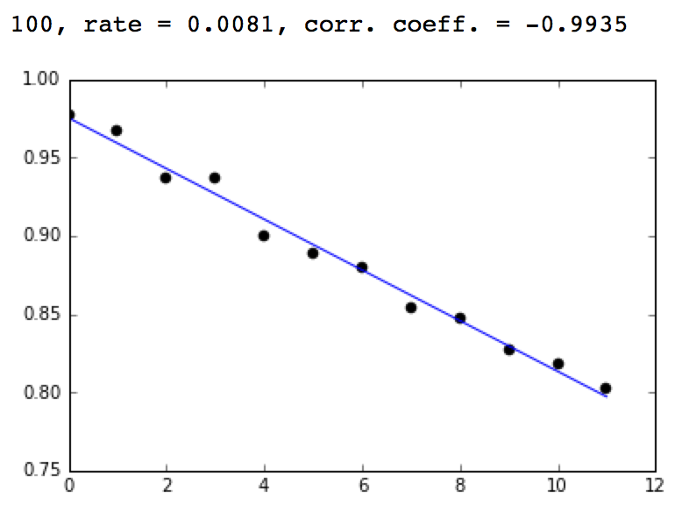
Step 3: Initial Rates Analysis
For each run, a plot of concentration vs. time is output, along with the regression parameters:
The rate is half the slope because this is a second-order reaction.
The points follow a straight line because this is a small slice of a slowly curving function.
[A] vs. time

Slide 13
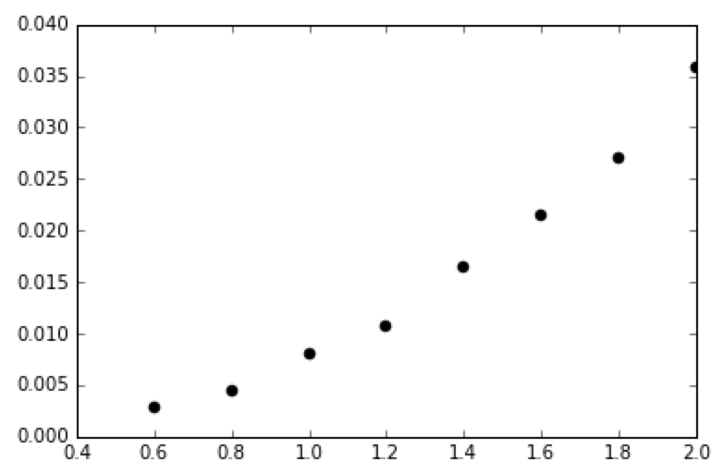
Step 3: Initial Rates Analysis
The final plot is of rate vs. intial concentration. It is parabolic:
Our next task will be to extract the rate constant, k, by fitting to rate = k [A]₀².
initial
rate
initial [A]

Slide 14
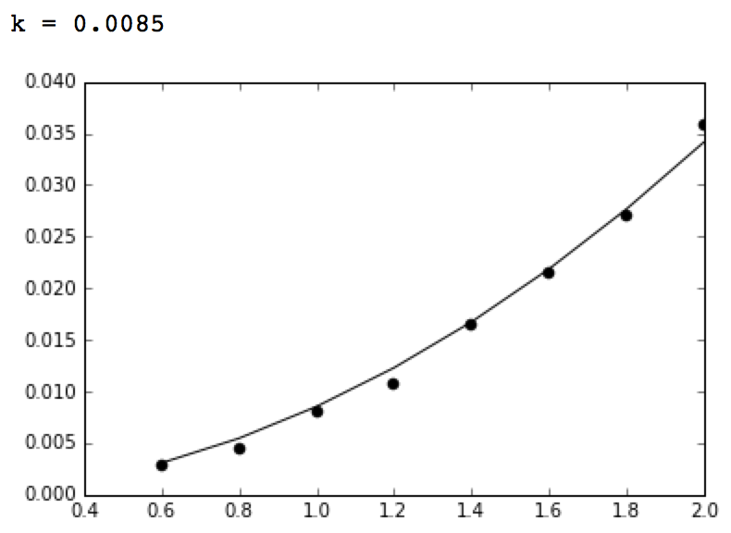
Step 4: Getting the Rate Constant
Note that the independent variable, A, must come first.
def second_order(A,k):
return k*A*A
popt,pcov = curve_fit(second_order, initial_concentrations, initial_rates)
print "k = %.4f" % popt[0]
fitted_rate = second_order(initial_concentrations, popt[0])
plt.plot(initial_concentrations, initial_rates, "ko")
plt.plot(initial_concentrations, fitted_rate, "k")
plt.show()
initial rate vs. [A]₀
The fit is very good. The rate
constant we obtain is in reasonable agreement with the actual value of 0.01.
(We can’t calculate the error in
the estimates because we haven’t used error bounds in the data.)

Slide 15
Step 5: Rate vs. Concentration
The initial rates approach was very easy, but it throws away the data from 80% of the reaction. Can we get a more accurate answer?
The last ten slides were concerned with converting concentration vs. time to rate vs. initial concentration. Now, we’ll try to get to rate vs. concentration for the entire reaction by differentiating:
polynomial_order = 7
measured_concentration = df.A60
poly_coeff = np.polyfit(time, measured_concentration, polynomial_order)
polynomial = np.poly1d(poly_coeff)
fitted_concentration = polynomial(time)
plt.plot(time, measured_concentration, "b.")
plt.plot(time, fitted_concentration, "r.")
plt.show()
residual = measured_concentration - fitted_concentration
plt.plot(time,residual)
plt.show()
RMSE = np.sqrt(np.mean(np.square(residual)))
print RMSE

Slide 16
Step 5: Rate vs. Concentration
The initial rates approach was very easy, but it throws away the data from 80% of the reaction. Can we get a more accurate answer?
The last ten slides were concerned with converting concentration vs. time to rate vs. initial concentration. Now, we’ll try to get to rate vs. concentration for the entire reaction by differentiating:
polynomial_order = 3
measured_concentration = df.A60
poly_coeff = np.polyfit(time, measured_concentration, polynomial_order)
polynomial = np.poly1d(poly_coeff)
fitted_concentration = polynomial(time)
plt.plot(time, measured_concentration, "b.")
plt.plot(time, fitted_concentration, "r.")
plt.show()
residual = measured_concentration - fitted_concentration
plt.plot(time,residual)
plt.show()
RMSE = np.sqrt(np.mean(np.square(residual)))
print RMSE
“Fit the [A]₀ = 0.60 M data to a third order polynomial. Use the polynomial derivative to compute the rate as a function of time. Plot the result. Calculate the residual and root-mean-square-error of the fit.”

Slide 17
Step 5: Rate vs. Concentration
Fit to a cubic polynomial. The choice of a polynomial function
is arbitrary. Any smooth and differentiable interpolation would do.
polynomial_order = 3
measured_concentration = df.A60
poly_coeff = np.polyfit(time, measured_concentration, polynomial_order)
polynomial = np.poly1d(poly_coeff)
fitted_concentration = polynomial(time)
plt.plot(time, measured_concentration, "b.")
plt.plot(time, fitted_concentration, "r.")
plt.show()
residual = measured_concentration - fitted_concentration
plt.plot(time,residual)
plt.show()
RMSE = np.sqrt(np.mean(np.square(residual)))
print RMSE
Use the data from the [A]₀ = 0.60 M run.
This is DataFrame “access method 1.”
Perform the polynomial fit. (The syntax is
polyfit(x, y, polynomial_order)).
Then, take the derivative of the polynomial
and calculate the rate with broadcasting.
Calculate the root-mean-square error.

Slide 18
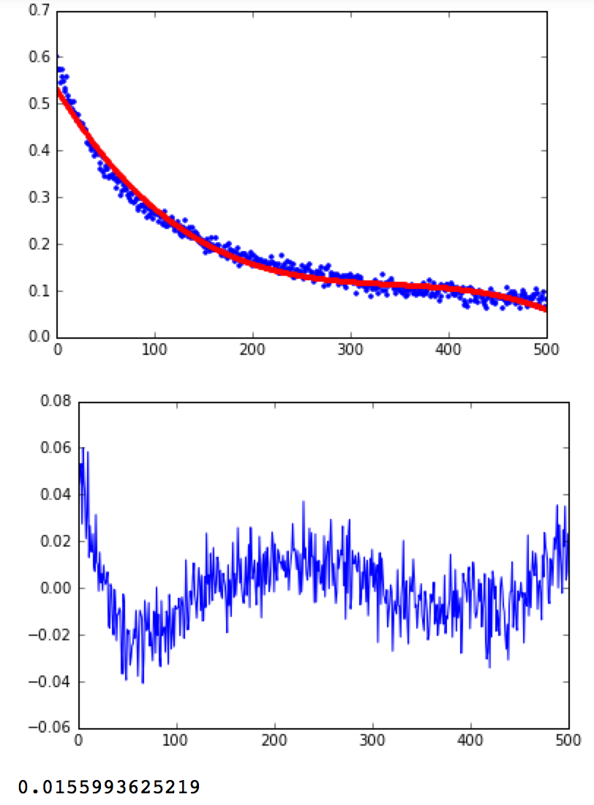
Step 5: Rate vs. Concentration
The fit is shown in red. Notice that it looks wavy, particularly near the edges of the dataset.
This occurs because the shape of the polynomial is different from the shape of the data. The “ringing” at the edge of datasets when fitting is a kind of Gibbs phenomenon.
The residuals emphasize the poor fit at the edges of the dataset, despite the relatively good RMSE (printed in molar).
We can reduce the ringing by using a higher order polynomial. Set polynomial_order to 7 and try again.
[A] vs. time
residual concentration vs. time

Slide 19
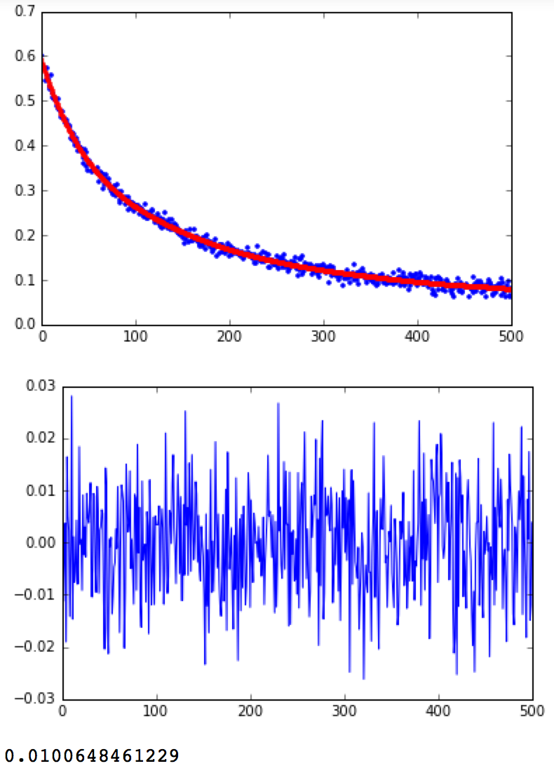
Step 5: Rate vs. Concentration
[A] vs. time
This time, the fit is much better.
If you look carefully, the rate the beginning and end is still a bit anomalous.
How did we know to use a 7th order polynomial?
One rule is to use the smallest degree polynomial that fits the data to avoid overfitting. (One can apply various statistical tests as well.)
In this case, we can take advantage of the fact that we have multiple runs of data.
residual vs. time

Slide 20
Step 5: Rate vs. Concentration
Let’s repeat the process for all the datasets at the same time. To avoid repeating ourselves, we’ll make a function:
polynomial_order = 7
def estimate_rate(index):
concentration = df["A%d" % index]
poly_coeff = np.polyfit(time, concentration, polynomial_order)
polynomial = np.poly1d(poly_coeff)
fitted_concentration = polynomial(time)
derivative = np.polyder(polynomial)
rate_vector = -0.5*derivative(time)
df["rate%d" % index]=Series(rate_vector, index=time)
plt.plot(concentration, rate_vector)
for i in range(60,220,20):
estimate_rate(i)
plt.show()

Slide 21
Step 5: Rate vs. Concentration
Let’s repeat the process for all the datasets at the same time. To avoid repeating ourselves, we’ll make a function:
polynomial_order = 7
def estimate_rate(index):
concentration = df["A%d" % index]
poly_coeff = np.polyfit(time, concentration, polynomial_order)
polynomial = np.poly1d(poly_coeff)
fitted_concentration = polynomial(time)
derivative = np.polyder(polynomial)
rate_vector = -0.5*derivative(time)
df["rate%d" % index]=Series(rate_vector, index=time)
plt.plot(concentration, rate_vector)
for i in range(60,220,20):
estimate_rate(i)
plt.show()
The same polynomial order will be used for every dataset.
Pull out the relevant dataset using method 2.
This is the same polynomial fitting as before.
Remember, the rate is half of the derivative.
Store the result in the master DataFrame. You can see new columns like rate60 have been added if you type df.head().
Run the function once per dataset. Remember, the range function does
not include the endpoint of the interval in the returned list. That means
we have to put the endpoint as 220, even though we only have data up
to 200.
This will overlay all the rate vs. concentration plots on one graph.

Slide 22
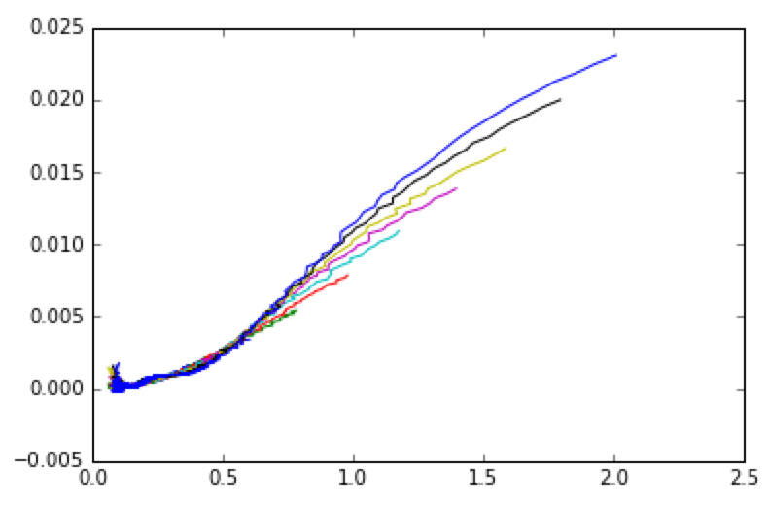
Step 5: Rate vs. Concentration
Each fit is given a different color. Theoretically, they should all overlay:
The fact that the curves don’t overlay (and aren’t parabolic) means the rate is being estimated poorly. Notice how the overlay is good at moderate concentrations. That’s because the middle of each dataset is where the rate is estimated best.
Try again with polynomial_order=15.
rate
polynomial_order=7
[A]

Slide 23
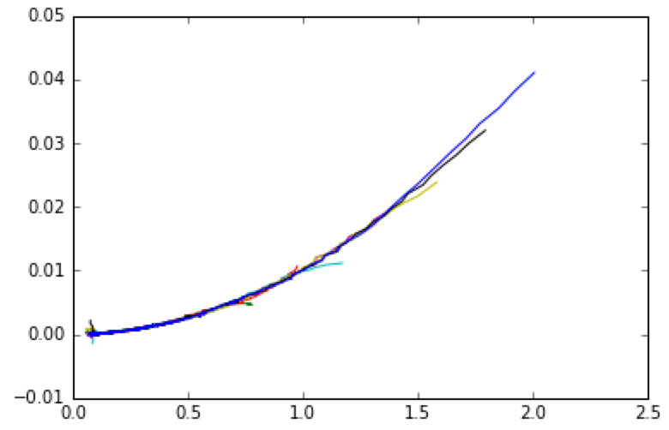
Step 5: Rate vs. Concentration
Despite some obvious edge artifacts, this overlays well and is correctly parabolic:
.
Remember, graphs like these should be read from right (low conversion) to left (high conversion).
rate
polynomial_order=15
[A]

Slide 24
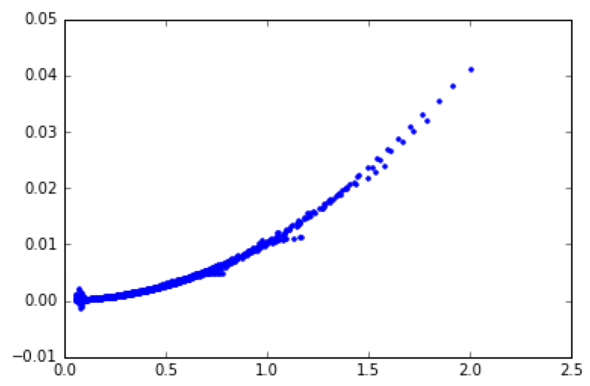
Step 6: Getting the Rate Constant in Aggregate
Let’s combine all the runs into one and obtain the rate constant from the aggregate dataset.
x = []
y = []
for index in range(60,220,20):
this_A = df["A%d" % index]
this_rate = df["rate%d" % index]
x.extend(this_A)
y.extend(this_rate)
x = np.array(x)
y = np.array(y)
plt.plot(x,y,"b.")
This uses method 2 for accessing the data again.
extend adds one list to the end of another.
If we wanted to be more sophisticated, we could remove the outliers, but this is good enough for now. (You would perform the fitting in the next step twice, once to identify the outliers, and once to fit without the outliers.)
rate
polynomial_order=15
[A]

Slide 25
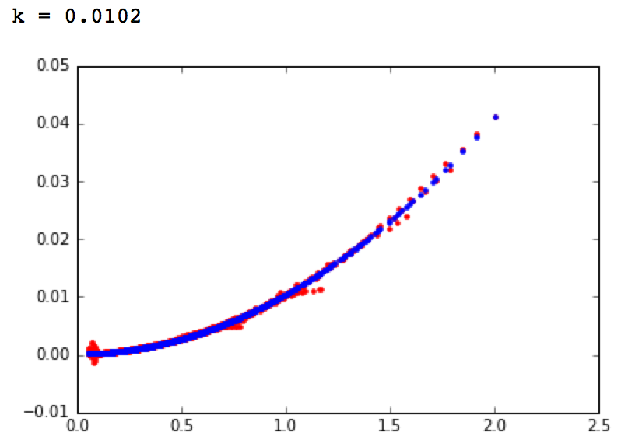
Step 6: Getting the Rate Constant in Aggregate
This is the fitting code:
popt,pcov = curve_fit(second_order, x, y)
print "k = %.4f" % popt[0]
fitted = second_order(x, popt[0])
plt.plot(x, y, "r.")
plt.plot(x, fitted, "b.")
plt.show()
By using the all of the
data from each experiment,
and by combining all the
experiments, we get a
result that agrees much
more closely with the true
rate constant of 0.01.
rate
polynomial_order=15
[A]

Slide 26
Summary
Congratulations! You now know how to perform initial rates and reaction progress analyses.
Import Statements
import matplotlib
import matplotlib.pyplot as plt
%matplotlib inline
import numpy as np
import pandas as pd
from pandas import Series, DataFrame
from scipy.optimize import curve_fit
from scipy.stats import linregress
pandas and DataFrames
df = pd.read_csv("dataset2.csv")
df.set_index("time",inplace=True)
time = df.index
df.head()
# access method 1 (no special chars)
df.A60
# access method 2
df[“A60”]
# access method 2 with %
key_name = “A%d” % index
df[key_name]
# iterating two lists in parallel
for t, c in zip(time, concentration):
...your code here...
Linear Regression
# slope, intercept, correlation coefficient
# p-value, standard error of estimate
m, b, r, p, err = linregress(x,y)
Polynomial Fitting
# returns the polynomial coefficients as a list
poly_coeff = np.polyfit(x, y, polynomial_order)
# make a numpy polynomial object
polynomial = np.poly1d(poly_coeff)
# broadcast the polynomial on x
# like a list comprehension, but more concise
fitted_y = polynomial(x)
# returns a numpy polynomial object that is
# the derivative of the original polynomial
derivative = np.polyder(polynomial)
# broadcast the derivative on x
y_prime = derivative(x)
# calculate the residual
residual = y – fitted_y
# calculate the root-mean-square error
RMSE = np.sqrt(np.mean(np.square(residual)))
print RMSE

